Slide 1
Market Structure and Pricing

Slide 2
Meaning and Definition of Market
Market generally means a place or a geographical area, where buyers with money and sellers with their goods meet to exchange goods for money.
In Economics market refers to a group of buyers and sellers who involve in the transaction of commodities and services.

Slide 3
Characteristics of a market
1. Existence of buyers and sellers of the commodity.
2. The establishment of contact between the buyers and sellers.
3. Buyers and sellers deal with the same commodity or variety.
4. There should be a price for the commodity bought and sold in the market.

Slide 4
Classification of Markets
A) Market according to Area - based on the extent of the market for any product, markets can be classified into local regional, national and international markets.

Slide 5
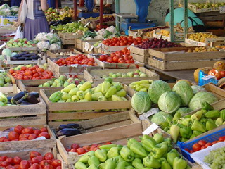
Classification of Markets
Local Market
A local market for a product exists when buyers and sellers of commodity carry on business in a particular locality or village or area where the demand and supply conditions are influenced by local conditions only. E.g. Perishable goods like milk and vegetables and bulky articles like bricks and stones.

Slide 6
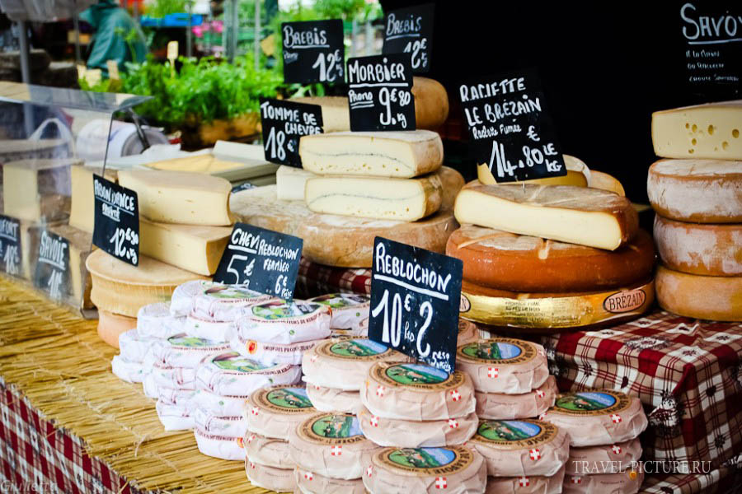
Classification of Markets
Regional Market
Commodities that are demanded and supplied over a region have regional market.

Slide 7
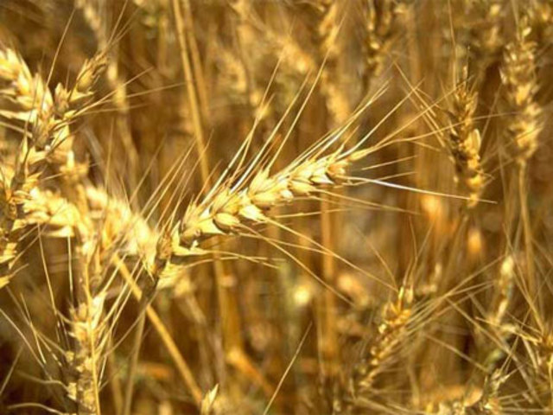
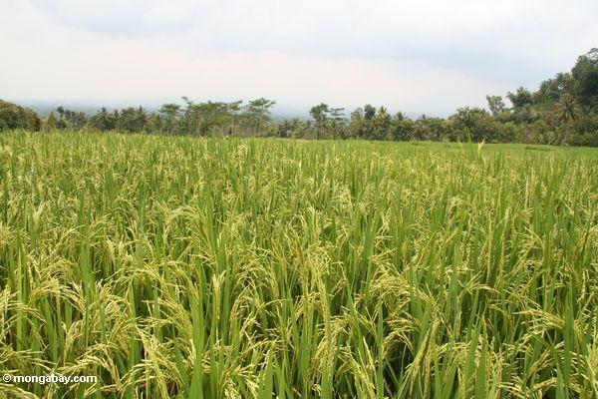
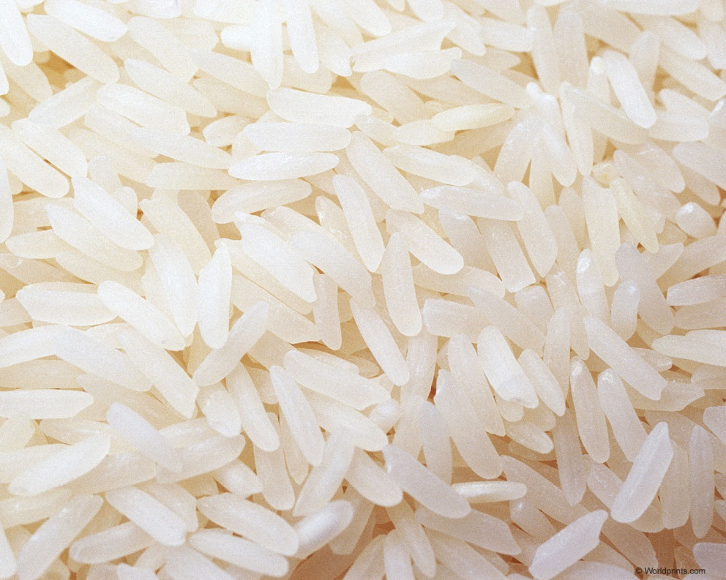
Classification of Markets
National Market
When commodities are demanded and supplied throughout the country, there is national market e.g. wheat, rice or cotton

Slide 8
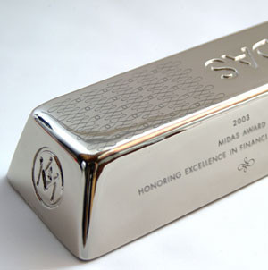
Classification of Markets
Global Market
When demand and supply conditions are influenced at the global level, we have international market. e.g. gold, silver, cell phone etc.

Slide 9
Classification of Markets
B) Market according to time
Marshall classified market based on the time element.
In economics “time” does not mean clock time. It means only the division of time based on extent of adjustability of supply of a commodity for a given change in its demand.

Slide 10
Classification of Markets
C) Market according to competition
These markets are classified according to the number of sellers in the market and the nature of the commodity. The classification of market according to competition is as follows.

Slide 11
Classification of Markets
Market
Perfect competition
(Large number of sellers
selling homogeneous
products)
Imperfect competition
Monopoly Duopoly Oligopoly Monopolistic competition
(Single Seller) (2 Sellers) A few sellers Large number of
selling homogeneous sellers selling
differentiated products differentiated products

Slide 12
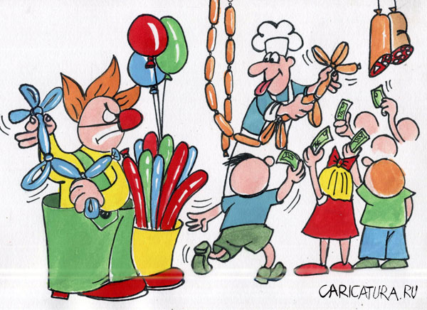
Classification of Markets
Perfect Competition
Perfect competition is a market situation where there are infinite
number of sellers that no one is big enough to have any appreciable
influence over market price.

Slide 13
Features and Conditions of perfect competition
1. Large number of buyers and sellers
The price is determined by market forces namely the demand for and the supply of the product.
Sellers accept this price and adjust the quantity produced to maximize their profit.

Slide 14
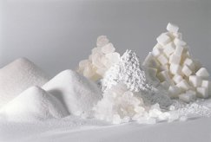
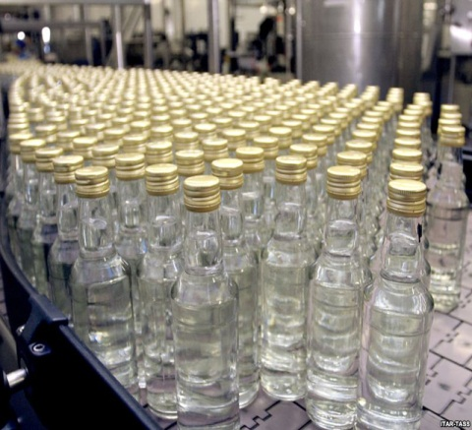
Features and Conditions of perfect competition
2. Homogeneous Product
The products produced by all the firms in the perfectly competitive market must be homogeneous and identical in all respects i.e. the products in the market are the same in quantity, size, taste, etc.
The products of different firms are perfect substitutes and the cross-elasticity
is infinite.

Slide 15
Features and Conditions of perfect competition
3. Perfect knowledge about market conditions
Both buyers and sellers are fully aware of the current price in the market. Therefore the buyer will not offer high price and the sellers will not accept a price less than the one prevailing in the market.

Slide 16
Features and Conditions of perfect competition
4. Free entry and Free exit
There must be complete freedom for the entry of new firms or the exit of the existing firms from the industry. When the existing firms are earning super-normal profits, new firms enter into the market.

Slide 17
Features and Conditions of perfect competition
5. Perfect mobility of factors of production
The factors of productions should be free to move from one use to another or from one industry to another easily to get better remuneration. The assumption of perfect mobility of factors is essential to fulfill the first condition namely large number of producers in the market.

Slide 18
Features and Conditions of perfect competition
6. Absence of transport cost
In a perfectly competitive market, it is assumed that there are no transport costs. Under perfect competition, a commodity is sold at uniform price throughout the market. If transport cost is incurred, the firms nearer to the market will charge a low price than the firms far away. Hence it is assumed that there is no transport cost

Slide 19
Features and Conditions of perfect competition
7. Absence of Government or artificial restrictions or collusions
There are no government controls or restrictions on supply, pricing etc. There is also no collusion among buyers or sellers. The price in the perfectly competitive market is free to change in response to changes in demand and supply conditions.

Slide 20
Advantages of perfect competition
1. There is consumer sovereignty in a perfect competitive market.
The consumer is rational and he has perfect knowledge about the market conditions. Therefore, he will not purchase the products at a higher price.

Slide 21
Advantages of perfect competition
2. In the perfectly competitive market, the price is equal to the minimum average cost. It is beneficial to the consumer.

Slide 22
Advantages of perfect competition
3. The perfectly competitive firms are price-takers and the products
are homogeneous. Therefore it is not necessary for the producers to incur expenditure on advertisement to promote sales. This reduces the wastage of resources.

Slide 23
Advantages of perfect competition
4. In the long run, the perfectly competitive firm is functioning at the
optimum level. This means that maximum economic efficiency in
production is achieved.
As the actual output produced by the firm is equal to the optimum output, there is no idle or unused or excess
capacity.

Slide 24
Monopoly
Monopoly is a market structure in which there is a single seller, there are no close substitutes for the commodity it produces and there are barriers to entry.

Slide 25
Characteristics of Monopoly
1. Single Seller: There is only one seller; he can control either price
or supply of his product. But he cannot control demand for the
product, as there are many buyers

Slide 26
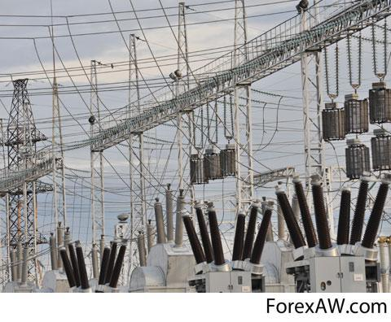
Characteristics of Monopoly
2. No close Substitutes: There are no close substitutes for the product. The buyers have no alternatives or choice. Either they have to buy the product or go without it.

Slide 27
Characteristics of Monopoly
3. Price: The monopolist has control over the supply so as to increase
the price. Sometimes he may adopt price discrimination. He may fix different prices for different sets of consumers. A monopolist can either fix the price or quantity of output; but he cannot do both, at the same time.

Slide 28
Characteristics of Monopoly
4. No Entry: There is no freedom to other producers to enter the market as the monopolist is enjoying monopoly power. There are strong barriers for new firms to enter. There are legal,
technological, economic and natural obstacles, which may block the entry of new producers.

Slide 29
Characteristics of Monopoly
5. Firm and Industry: Under monopoly, there is no difference
between a firm and an industry. As there is only one firm, that single firm constitutes the whole industry.

Slide 30
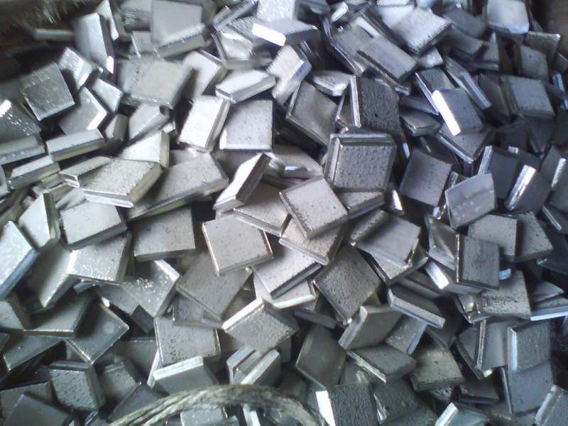
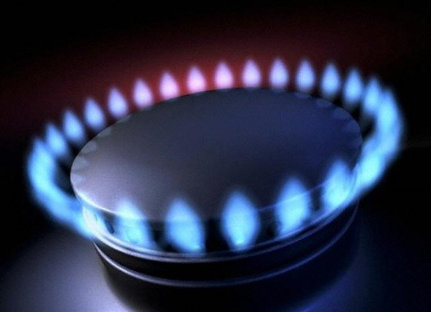
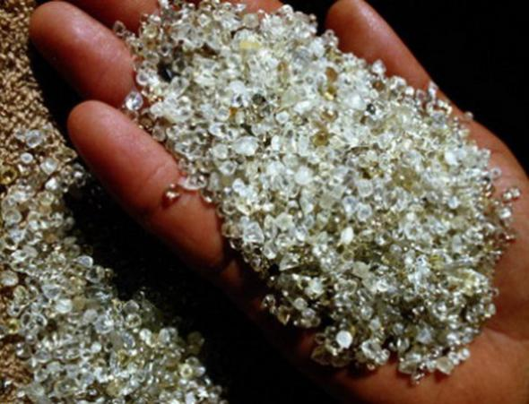
Causes for Monopoly
1. Natural: A monopoly may arise on account of some natural causes.
Some minerals are available only in certain regions. For example,
South Africa has the monopoly of diamonds; nickel in the world is
mostly available in Canada and oil in Middle East, gas in Russia. This is natural monopoly.

Slide 31
Causes for Monopoly
2. Technical: Monopoly power may be enjoyed due to technical reasons. A firm may have control over raw materials, technical knowledge, special know-how, scientific secrets and formula that enable a monopolist to produce a commodity.

Slide 32
Causes for Monopoly
3. Legal: Monopoly power is achieved through patent rights, copyright and trade marks by the producers. This is called legal monopoly.

Slide 33
Causes for Monopoly
4. Large Amount of Capital: The manufacture of some goods requires a large amount of capital or lumpiness of capital. All firms cannot enter the field because they cannot afford to invest such a large amount of capital. This may give rise to monopoly.
For example, iron and steel industry, railways, etc.

Slide 34
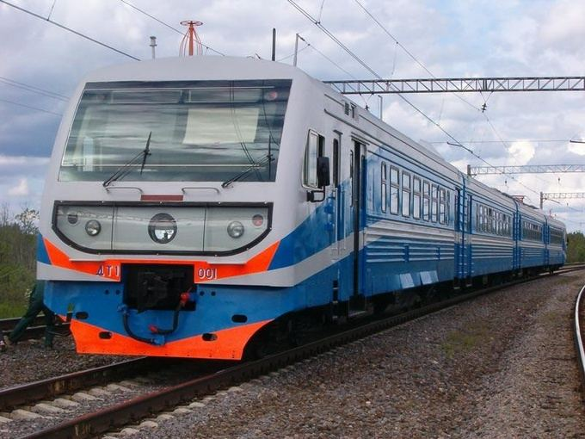
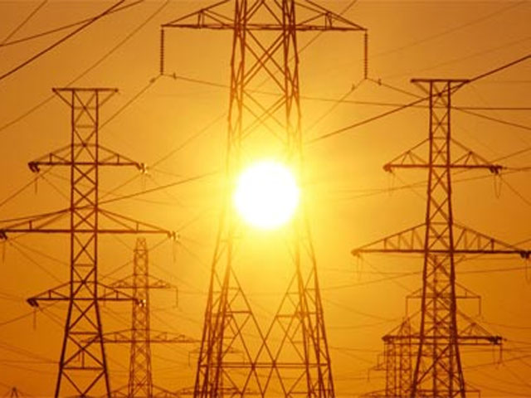
Causes for Monopoly
5. State: Government will have the sole right of producing and selling some goods. They are State monopolies. For example, we have public utilities like electricity and railways. These public utilities are undertaken by the State.

Slide 35
Advantages of Monopoly
1. Monopoly firms have large-scale production possibilities and also
can enjoy both internal and external economies.
This will result in the reduction of costs of production. Output can be sold at low prices. This is beneficial to the consumers.

Slide 36
Advantages of Monopoly
2. Monopoly firms have vast financial resources which could
be used for research and development. This will enable the firms to innovate quickly.

Slide 37
Advantages of Monopoly
3. There are a number of weak firms in an industry. These firms can combine together in the form of monopoly to meet competition.
In such a case, market can be expanded.

Slide 38
Disadvantages of Monopoly
1) A monopolist always charges a high price, which is higher than the competitive price.
Thus a monopolist exploits the consumers.

Slide 39
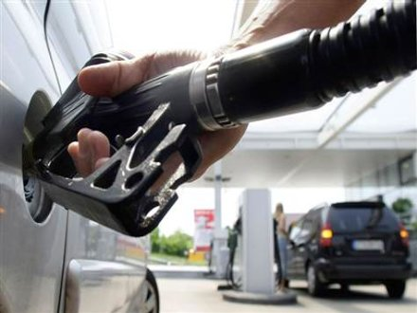
Disadvantages of Monopoly
2. A monopolist is interested in getting maximum profit. He may
restrict the output and raise prices. Thus, he creates artificial scarcity for his product.

Slide 40
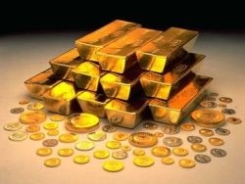
Disadvantages of Monopoly
3. A monopolist often charges different prices for the same product from different consumers. He extracts maximum price according to the ability to pay of different consumers.

Slide 41
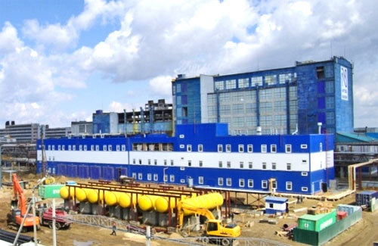
Disadvantages of Monopoly
4. A monopolist uses large-scale production and huge resources to
promote his own selfish interest. He may adopt wrong practices to establish absolute monopoly power.

Slide 42
Disadvantages of Monopoly
5. In a country dominated by monopolies, wealth is concentrated in the hands of a few. It will lead to inequality of incomes. This is against the principle of the socialistic pattern of society.

Slide 43
Methods of Controlling Monopoly
1. Legislative Method: Government can control monopolies by legal actions. Anti-monopoly legislation has been enacted to check the growth of monopoly.

Slide 44
Methods of Controlling Monopoly
2. Controlling Price and Output: This method can be applied in the case of natural monopolies. Government would fix either price or output or both.

Slide 45
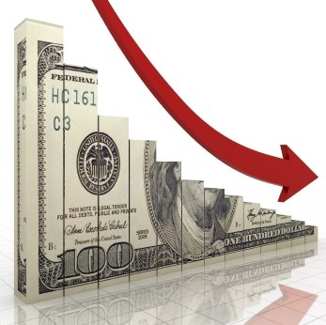
Methods of Controlling Monopoly
3. Taxation: Taxation is another method by which the monopolistic power can be prevented or restricted. Government can impose a lump-sum tax on a monopoly firm, irrespective of its level of output.
Consequently, its total profit will fall.

Slide 46
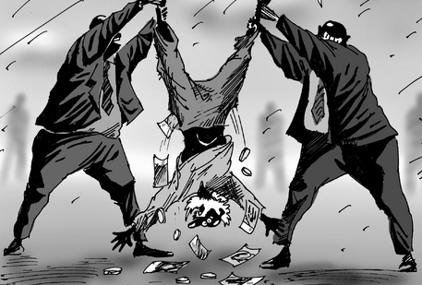
Methods of Controlling Monopoly
4. Nationalization: Nationalizing big companies is one of the solutions.
Government may take over such monopolistic companies, which are exploiting the consumers.

Slide 47
Methods of Controlling Monopoly
5. Consumer’s Association: The growth of monopoly power can also be controlled by encouraging the formation of consumers associations to improve the bargaining power of consumers.

Slide 48
Price Discrimination
Price discrimination means the practice of selling the same commodity at different prices to different buyers. If the monopolist charges different prices from different consumers for the same
commodity, it is called price discrimination or discriminating monopoly.

Slide 49
Price Discrimination
Price discrimination may be defined as “the sale of technically
similar products at prices which are not proportional to marginal
cost”. For example, all cinema theatres charge different prices for
different classes of people.

Slide 50
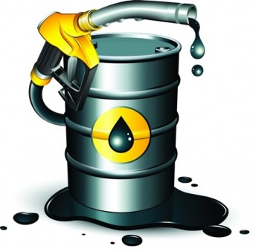
Monopolistic Competition
Monopolistic competition, as the name itself implies, is a blending
of monopoly and competition. Monopolistic competition refers to the market situation in which a large number of sellers produce goods which are close substitutes of one another. The products are similar but not identical.

Slide 51
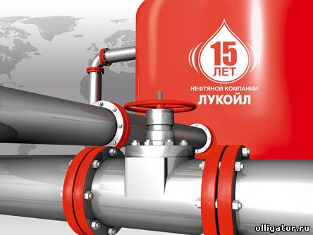
Characteristics of Monopolistic Competition
Existence of Large Number of firms
Under monopolistic competition, the number of firms producing a commodity will be very large. The term ‘very large’ denotes that contribution of each firm towards the total demand of the product is small.

Slide 52
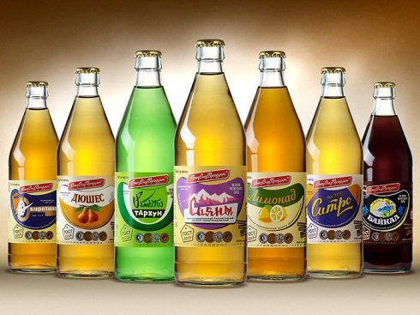
Characteristics of Monopolistic Competition
2. Product differentiation: Product differentiation is the essence of monopolistic competition. Product differentiation is the process of
altering goods that serve the same purpose so that they differ in minor
ways.
For example, soft drinks, "Lemonade", "Duchess", "Baikal"

Slide 53
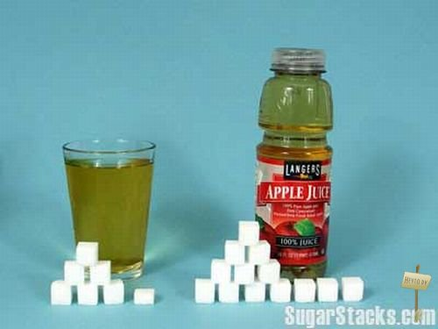
Characteristics of Monopolistic Competition
Product differentiation is attempted through (a) physical difference; (b)
quality difference; (c) imaginary difference and (d) purchase benefit
difference. It may be by using different quality of the raw material and
different chemicals and mixtures used in the product. Difference in workmanship, durability and strength will also make product differentiation.

Slide 54
Characteristics of Monopolistic Competition
3) Selling Costs
From the discussion of ‘product differentiation’, we can infer that the producer under monopolistic competition has to incur expenses to popularize his brand. This expenditure involved in selling the product is called selling cost.

Slide 55
Characteristics of Monopolistic Competition
According to Prof. Chamberlin,
selling cost is “the cost incurred in order to alter the position or shape of the demand curve for a product”. Most important form of selling cost is advertisement.

Slide 56
Characteristics of Monopolistic Competition
4. Freedom of entry and exit of firms
Any firm to enter into the field and produce the commodity under its own brand name and any firm can go out of the field if so chosen. There are no barriers as in the case of monopoly.
In monopolistic competition, the features of monopoly and perfect competition are partially present.

Slide 57
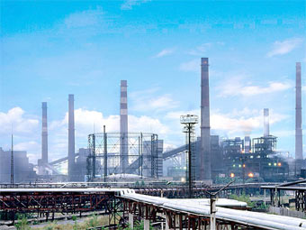
Wastages of Monopolistic competition
Unemployment.
Under monopolistic competition, the firms produce less than optimum output. As a result, the productive capacity is not used to the fullest extent. This will lead to unemployment of resources.

Slide 58
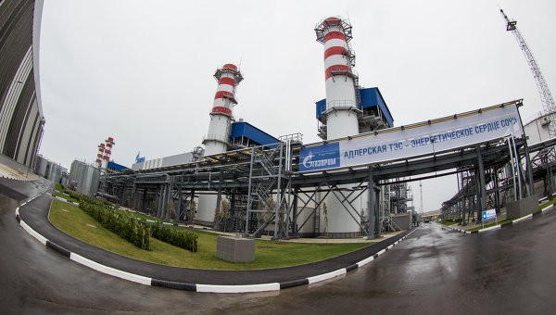
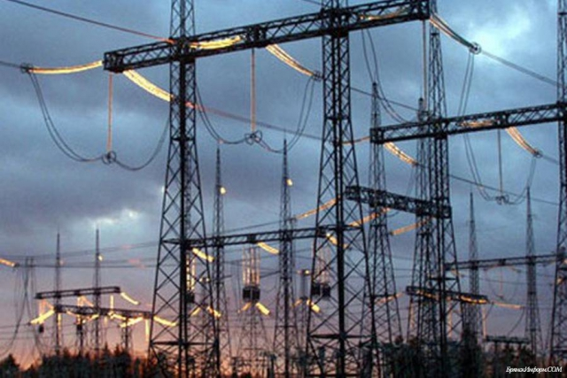
Wastages of Monopolistic competition
2. Excess capacity.
It is the difference between the
optimum output that can be produced and the actual output produced by the firm.

Slide 59
Wastages of Monopolistic competition
3. Advertisement: There is a lot of waste in competitive
advertisements under monopolistic competition. The wasteful and competitive advertisements lead to high cost to consumers.

Slide 60
Wastages of Monopolistic competition
4. Too Many Varieties of Goods
Introducing too many varieties
of a good is another waste of monopolistic competition. The goods differ in size, shape, style and colour. A reasonable number of
varieties would be desirable.

Slide 61
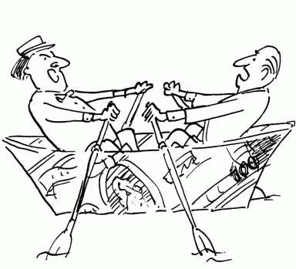
Oligopoly
Oligopoly refers to a form of imperfect competition where there will be only a few sellers producing either homogenous or differentiated products.

Slide 62
Characteristics of Oligopoly
Interdependence.
Since there are a few firms, each firm closely watches the activities of the other firm. Any change in price, output, product, etc., by a firm will have a direct effect on the fortune of its rivals. So an oligopolistic firm must consider not only the market demand for its product, but also the possible moves of other firms in the industry.

Slide 63
Characteristics of Oligopoly
2. Group Behavior.
Firms may realize the importance of mutual co-operation. Then they will have a tendency of collusion. At the same time, the desire of each firm to earn maximum profit may encourage competitive spirit. Thus, co-operative and collusive trend as well as competitive trend would prevail in an oligopolistic
market.

Slide 64
Characteristics of Oligopoly
3. Price Rigidity:
Price is sticky or rigid at the prevailing level due to the fear of reaction from the rival firms.
If an oligopolistic firm lowers its price, the price reduction will be followed by the rival firms. As a result, the firm loses its profit.
If the oligopolistic firm raises the price, the rival firms will not follow. This would result in losing customers. In both ways the firm would face difficulties.

