Slide 1
Economic Regulation

Slide 2
The importance of Economic Regulation
Regulation seeks to make such improvement by changing individual or organizational behaviour
in ways that generate positive impacts in terms of solving societal and economic problems. At its most basic level, regulation is designed to work according to three main steps:

Slide 3
three main steps:
1. Regulation is implemented, which leads to changes in…….
2. The behaviour of individuals or entities targeted or affected by regulation, which ultimately leads to changes in…….
3. Outcomes, such as amelioration in an underlying problem or other (positive) changes in conditions in the world.

Slide 4
What is regulation?
Regulations are rules or norms adopted by government and backed up by some threat of consequences, usually negative ones in the form of penalties.
Often directed at businesses, regulations can also take aim at nonprofit organisations, other governmental entities, and even individuals.

Slide 5
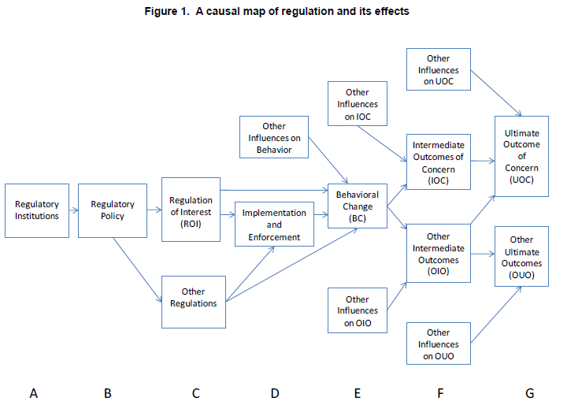
A causal map of regulation and its effects
The figure maps out in a general way the relationships between distinct steps in the development and implementation of any regulation

Slide 6
A casual map of regulation and its effects
The figure maps out in a general way the relationships between distinct steps in the development and implementation of any regulation, leading to its eventual effects.

Slide 7
A casual map of regulation and its effects
Step A: Regulatory Institution. Regulatory decisions and actions emanate from a governmental entity, whether a parliament or a ministry or some other body. This institution will have its own organizational characteristics and will exist within a larger environment having various political, social, and economic pressures and constraints.

Slide 8
A casual map of regulation and its effects
Step B: Regulatory policy.
The organizational and environmental characteristics that make up the regulatory institution will be general ones, rather than rules, procedures, or practices specifically directed at regulatory decision making and behaviour. All the various rules, procedures, and practices related to regulation will, for simplicity, be referred to here as ― regulatory policy.

Slide 9
A casual map of regulation and its effects
Step B: Regulatory policy.
Regulatory policy includes transparency and consultation rules, such as requirements for public notice of proposed regulations, public access to key meetings, or disclosure of relevant information relied upon by governmental decision makers. Regulatory policy also includes processes for certain types of planning and analysis to be conducted prior to a regulatory decision, such as regulatory impact analysis, cost-benefit analysis, impacts on small businesses or local governments.

Slide 10
A casual map of regulation and its effects
Step C: Regulation.
In addition to the regulation under evaluation – the ― regulation of interest (ROI) – there will be other regulations that exist and affect the behaviour of the individuals or organisations targeted by the ROI. These other regulations could emanate from the same or different regulatory institutions.

Slide 11
A casual map of regulation and its effects
Step D: Implementation.
A regulation conceivably could have immediate effects upon adoption. If the targets of regulation are committed to obeying the law, they may comply even before the government takes any steps to implement and enforce the rule.

Slide 12
A casual map of regulation and its effects
Step D: Implementation.
Regulators, however, seldom assume that compliance will be automatic. They implement rules by communicating what they require to affected organisations and individuals, even providing guidance or other assistance in complying. At times, they may even subsidise or reward those entities that do comply.

Slide 13
A casual map of regulation and its effects
Step D: Implementation.
More commonly they enforce regulations through inspections and monitoring designed to assess whether behaviour accords with rules, subjecting those not complying to the imposition of penalties.

Slide 14
A casual map of regulation and its effects
Step E: Behavioural change.
The first effect of a regulation is supposed to be on the behaviour of those individuals or organizations that it targets.
Step E includes boxes to represent the other influences that may affect the same outcomes that behavioural change could also affect.

Slide 15
A casual map of regulation and its effects
Step F: Intermediate outcomes.
Outcomes refer to conditions in the world. Initial changes in conditions in the world, ones that follow directly from behavioural changes, can be considered ― intermediate outcomes.

Slide 16
A casual map of regulation and its effects
Step F: Intermediate outcomes.
Figure 1 is obviously a highly simplified schematic, as in reality there will often be multiple layers of intermediate outcomes leading to the ultimate outcomes. There will also typically be intermediate outcomes that lead to other outcomes of concern – such as costs or various side effects.

Slide 17
A casual map of regulation and its effects
Step G: Ultimate outcomes.
The ― ultimate outcome of concern (UOC), as already noted, refers to the solution of or reduction in the primary problem that animated the regulation.

Slide 18
A casual map of regulation and its effects
Step G: Ultimate outcomes.
The ultimate outcome of concern might be the improvement of public health, safety,
environmental quality, domestic security, or economic competition.
Depending on the specific regulatory problem, these ― other ultimate outcomes (OUO) might include the costs of regulation, impacts on technological innovation, equity.

Slide 19
The purpose of the Principles for Economic Regulation is to:
1. Reaffirm the importance of, and the Government’s commitment to, stable and
predictable regulatory frameworks to facilitate efficient investment and sustainable growth

Slide 20
The purpose of the Principles for Economic Regulation is to:
2. Set the framework for delivering greater clarity about the respective roles of
Government, regulators and producers, and greater coherence in an increasingly complex and interlinked policy context;

Slide 21
The purpose of the Principles for Economic Regulation is to:
3. Set out the characteristics of a successful framework for economic regulation to guide policy makers in assessing future developments

Slide 22
The purpose of the Principles for Economic Regulation is to:
The Government is setting out a series of high level commitments to ensure these Principles are enshrined in Government’s policy-making on economic regulation. At a more detailed level, a targeted approach to applying the principles in individual sectors is likely to be more effective than a one-size-fits-all approach. The detailed application of the principles will therefore be for relevant Government departments to determine.

Slide 23
The principles state that any regulation should be transparent, accountable, proportionate, consistent and targeted.

Slide 24
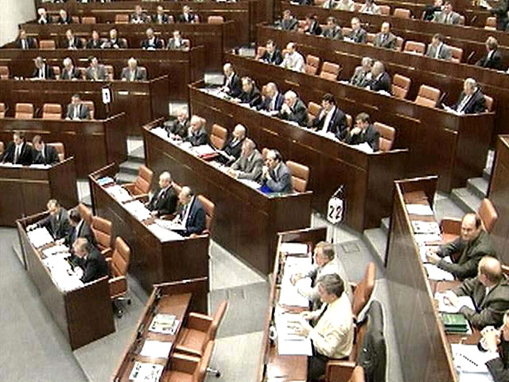
Accountability
• Independent regulation needs to take place within a framework of duties and policies set by a democratically accountable Parliament and Government

Slide 25
Accountability
• Roles and responsibilities between Government and economic regulators should be allocated in such a way as to ensure that regulatory decisions are taken by the body that has the legitimacy, expertise and capability to arbitrate between the required trade-offs

Slide 26
Accountability
• Decision-making powers of regulators should be, within the constraints imposed by the need to preserve commercial confidentiality, exercised transparently and subject to appropriate scrutiny and challenge

Slide 27
Focus
• The role of economic regulators should be concentrated on protecting the interests of end users of infrastructure services (current and future consumers, and in some sectors taxpayers, who ultimately pay for the services)

Slide 28
Focus
• Economic regulators should have clearly defined, articulated and prioritised statutory responsibilities focused on outcomes rather than specified inputs or tools by ensuring the operation of well-functioning and contestable markets where appropriate or by designing a system of incentives and penalties that replicate as far as possible the outcomes of competitive markets.

Slide 29
Focus
• Economic regulators should have adequate discretion to choose the tools that best achieve these outcomes

Slide 30
Predictability
• The framework for economic regulation should provide a stable and objective environment enabling all those affected to anticipate the context for future decisions and to make long term investment decisions with confidence

Slide 31
Predictability
• The framework of economic regulation should not unreasonably unravel past decisions, and should allow efficient and necessary investments to receive a reasonable return, subject to the normal risks inherent in markets

Slide 32
Coherence
• Regulatory frameworks should form a logical part of the Government’s broader policy context, consistent with established priorities
• Regulatory frameworks should enable cross-sector delivery of policy goals where appropriate

Slide 33
Adaptability
The framework of economic regulation needs capacity to evolve to respond to changing circumstances and continue to be relevant and effective over time

Slide 34
Efficiency
Policy interventions must be proportionate and cost-effective while decision making should be timely, and robust

Slide 35
Applying the principles
Division of roles and
responsibilities
The aim of economic regulation is to create a system of incentives and penalties that aim to replicate the outcomes of competition in terms of consumer prices, quality and investment and puts the protection of consumers’ interests at its heart.
To achieve these objectives it is important to establish a clear division of responsibilities between the Government and economic regulators.

Slide 36
Applying the principles
Division of roles and responsibilities
For the system to be effective, the responsibilities need to be as clearly articulated as possible so that consumers and regulated firms know who is responsible for what and to whom they are accountable.
The Government commits to ensure that responsibilities are clearly divided between Government and regulator on the basis that high level decisions that involve political judgement are taken by Government and day-to-day regulatory decisions are undertaken by regulators.

Slide 37
Applying the principles
Reaffirming the independence
of regulation
The Government will preserve the independence of economic regulators. It will ensure that:
• regulators are legally distinct and functionally independent from any other public or private entity when carrying out their functions
• regulators’ staff and management act independently from any market interest and do not seek or take direct instructions from any government or other public or private entity when making regulatory decisions
• regulators can take autonomous decisions, independently from any political body, and have separate annual budget allocations, with autonomy in the implementation of the allocated budget, and adequate human and financial resources to carry out their duties.

Slide 38
Applying the principles
Reaffirming the independence of regulation
The Government will continue to ensure that it does not interfere with day-to-day regulatory decision making.
The Government will ensure regulators have discretion to choose the regulatory tools to deliver their objectives.
The Government will ensure that future changes preserve the independence of regulators.

Slide 39
Applying the principles
Coherent, adaptable but stable regulation
It is important that the regulatory frameworks
avoid adding undue uncertainty to the business environment.
To a large extent this is achieved by building a stable and transparent regulatory environment with a long track record of consistent regulatory decision making.
The Government will avoid making piecemeal and ad hoc changes to the system for economic regulation outside of this process to provide stability.

Slide 40
Applying the principles
Reinforcing accountability
Accountability is vital for ensuring an effective regulatory framework that delivers the desired outcome for consumers. It plays an extremely important role in establishing the legitimacy of decision makers. While regulators are independent of Government departments, they must, of course, exercise their discretion within the limits of the law and under the supervision of the relevant bodies.
Open and committed consultation about proposals plays an important role in strengthening transparency. It ensures that all parties can see and understand the logic and direction of travel of a regulator’s deliberations.

Slide 41
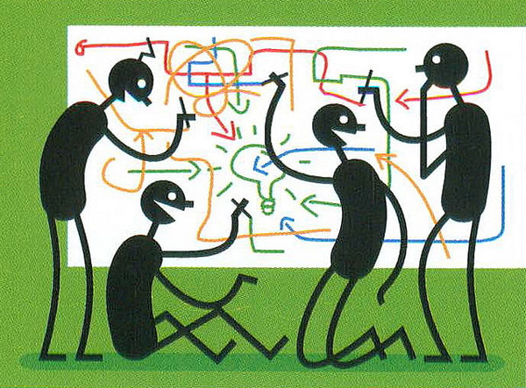
Applying the principles
Clarity and focus of regulators’ objectives
The Government will ensure that regulators’ objectives are clear and appropriately prioritised (including through broader guidance) to reflect the issues that the regulators should take into account in their decisions.

Slide 42
Applying the principles
Efficient and proportionate regulation
As well as being cost-effective, regulatory decisions need to be made in a timely manner. Infrastructure investments have long lead times. Delays to key decisions can cause uncertainty and raise the costs to industry or leave consumers unprotected.
Similarly, decisions must be based on robust evidence and judgement. The framework must therefore enable regulators to make timely, authoritative decisions.

Slide 43
Applying the principles
Cross-sector working
It is important that institutional arrangements recognize interdependencies between economic sectors

Slide 44
Write a note
«Why is it important that institutional arrangements recognize interdependencies between economic sectors»?

