Slide 1
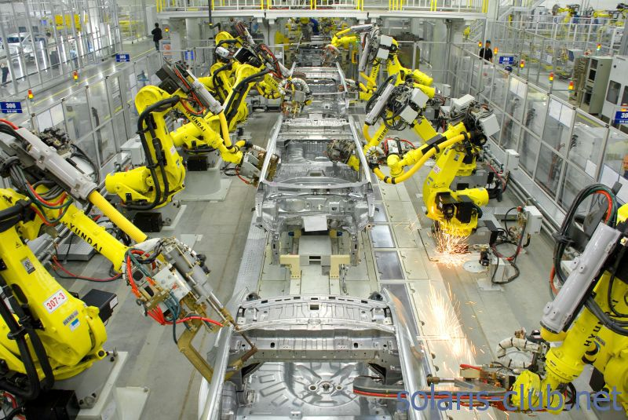
PRODUCTION

Slide 2
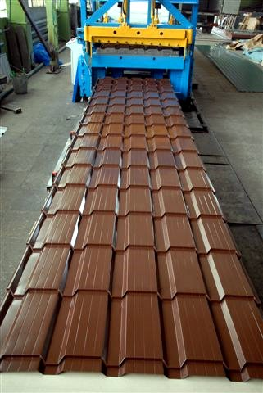
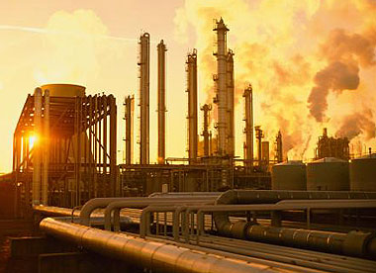
Meaning of Production
Production in Economics refers to the creation of those goods and services which have exchange value. It means the creation of utilities.
These utilities are in the nature of form utility, time utility and place utility.

Slide 3
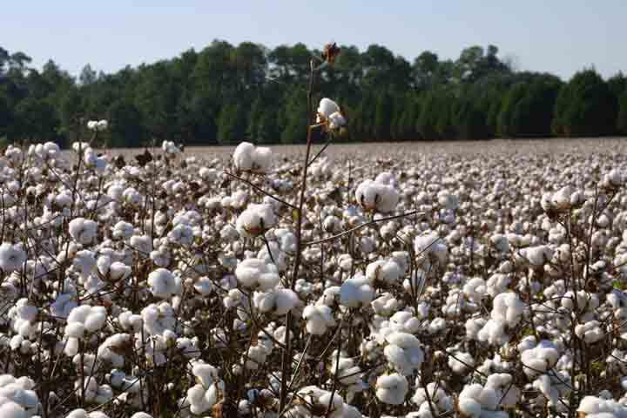
Reasons of commodity`s utility
1. Form Utility
If the physical form of a commodity is changed, its utility may increase.
For instance, the utility of cotton increases, if it is converted into clothes.

Slide 4
Reasons of commodity`s utility
2. Place Utility
If a commodity is transported from one place to another, its utility
may increase.

Slide 5
Reasons of commodity`s utility
3. Time Utility
If the commodity is stored for future usage, its utility may increase.
During rainy season, water is stored in reservoirs and it is used at a later time. This increases the utility of that stored water.

Slide 6
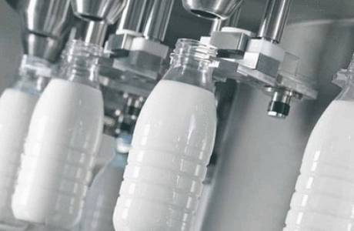
Reasons of commodity`s utility
4. Possession Utility
Commodities in the transaction process, change from one person to another person.
Commodities in the hands of producers have some
utility and by the time they reach consumers their utility is increased.

Slide 7
Kinds of factors of production
Factors of production
primary derived
(Land, Labor) (Capital, Organization )
Labor acts upon Land to produce goods and services and wealth. These two factors are naturally given and without them no goods can be produced.

Slide 8
Kinds of factors of production
Factors of production
primary derived
(Land, Labor) (Capital, Organization)
Capital and organization are derived from the primary factors of
production. These derived factors of production, when combined with the primary factors of production, raise total production.

Slide 9
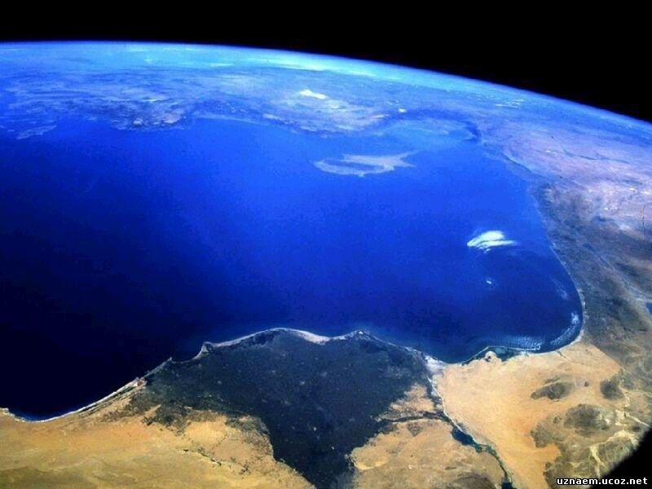
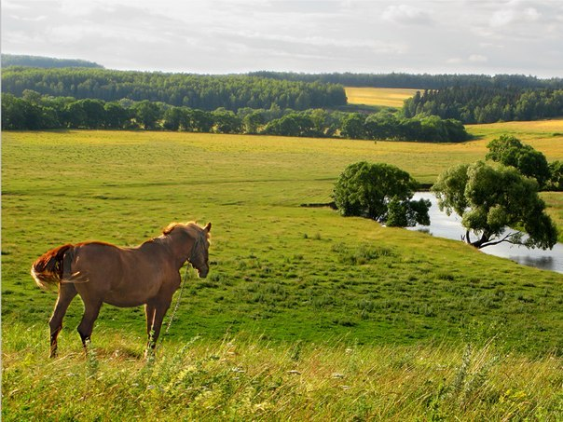
I. Land
Land as a factor of production refers to all those natural resources or gifts of nature which are provided free to man (labor).
Thus, ‘Land’ includes all things that are not made by man.

Slide 10
I. Land
Characteristics or Peculiarities of land
1. Land is a free gift of nature
2. Land is fixed (inelastic) in supply.
3. Land is imperishable
4. Land is immobile
5. Land differs in fertility and situation
6. Land is a passive factor of production

Slide 11
II. Labour
Labour is the human input into the production process.
Alfred Marshall defines labour as ‘the use or exertion of body or mind, partly or wholly, with a view to secure an income apart from the pleasure derived from the work’.

Slide 12
II. Labour
Characteristics or Peculiarities of labour
1. Labour is perishable.
2. Labour is an active factor of production. Neither land nor capital can yield much without labour.
3. Labour is not homogeneous. Skill and dexterity vary from person to person.
4. Labour cannot be separated from the labourer.
5. Labour is mobile. Man moves from one place to another from a low paid occupation to a high paid occupation.
6. Individual labour has only limited bargaining power.

Slide 13
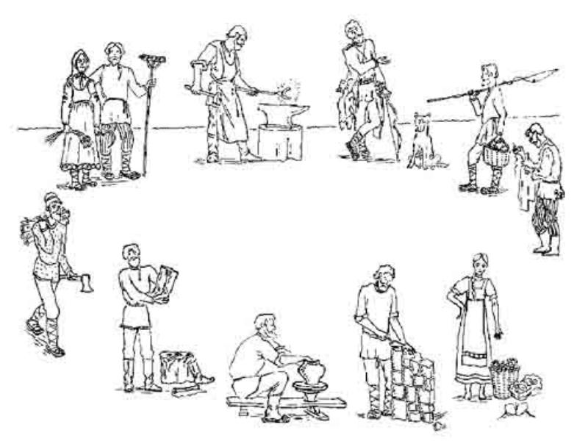
II. Labour
Labour can assume several forms. Digging earth, breaking stones, carrying loads comprise simple labour operations but labour also covers highly qualified and skilled managers, engineers and technicians.

Slide 14
Division of Labour
The concept ‘Division of Labour’ was introduced by Adam Smith
Division of Labour means dividing the process of production into distinct and several component processes and assigning each component in the hands of a labour or a set of labourers, who are specialists in that particular process.

Slide 15
Merits of Division of Labour
1. Division of labour improves efficiency of labour when labour repeats doing the same tasks.
2. Facilitates the use of machinery in production, resulting in inventions.
3. Time and materials are put to the best and most efficient use.

Slide 16
Demerits of Division of Labour
1. Repetition of the same task makes labour to feel that the work is monotonous and stale.
2. Narrow specialisation reduces the possibility of labour to find alternative avenues of employment.
3. Kills the growth of handicrafts and the worker loses the satisfaction of having made a commodity in full.

Slide 17
III. Capital
Capital is the man made
physical goods used to
produce other goods and
services.
In Economics, capital refers to that part of man-made wealth which is used for the further production of wealth.
According to Marshall, “Capital consists of those kinds of wealth other than free gifts of nature, which yield income”.

Slide 18
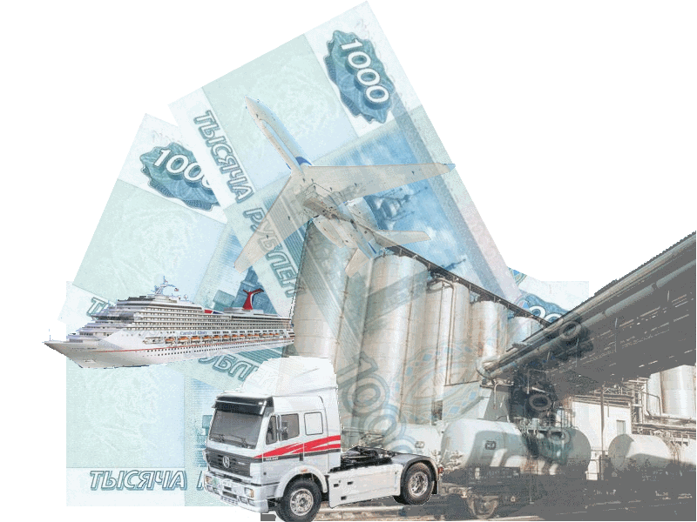
Forms of Capital
1. Physical Capital
All man-made physical assets like plant and machinery, tools, buildings, roads, dams and communication, etc., are the various forms of physical capital.

Slide 19
Characteristics of Physical capital
1) It is an asset which has a specific life period.
2) Physical capital asset can be used in production again and again.
3) When used in production, it gives a series of annual income flows called annuities, during its life period.
Accumulation of more and more physical capital is called physical capital formation

Slide 20
Forms of Capital
2. Money Capital
The investment that is made in the form of money or monetary instruments is called money capital.
A household saves its income in the form of bank deposits, shares and securities or other monetary instruments. These are the sources of money capital.

Slide 21
Forms of Capital
3. Human Capital
Human capital refers to the quality of labour resources, which can be improved through investments in education, training, and health.
Higher the investments in human capital, higher will be the productivity.

Slide 22
Characteristics of capital
1) Capital is a passive factor of production
2) Capital is man-made
3) Capital is not an indispensable factor of production
4) Capital has the highest mobility
5) Supply of capital is elastic
6) Capital is productive
7) Capital lasts over time (A plant may be in operation for a number of years)
8) Capital involves present sacrifice (cost) to get future benefits.

Slide 23
IV. Organization or entrepreneurship
An entrepreneur is a person who combines the different factors of production (land, labour and capital), in the right proportion and initiates the process of production and also bears the risk involved in it.
In modern times, an entrepreneur is called ‘the changing agent of the society’.

Slide 24
Functions of an Entrepreneur
1. Identifying Profitable Investible Opportunities
Conceiving a new and most promising and profitable idea or capturing a new idea available in the market is the foremost function of an entrepreneur. This is known as identifying profitable investible opportunities.

Slide 25
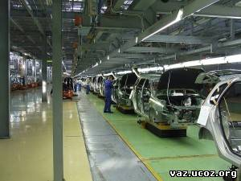
Functions of an Entrepreneur
2. Deciding the size of unit of production
An entrepreneur has to decide the size of the unit – whether big or small depending upon the nature of the product and the level of competition in the market.

Slide 26
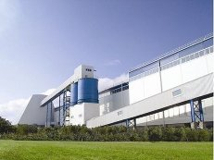
Functions of an Entrepreneur
3. Deciding the location of the production unit
A rational entrepreneur will always locate his unit of production nearer to both factor market and the end-use market.

Slide 27
Functions of an Entrepreneur
4. Identifying the optimum combination of factors of production
The entrepreneur, after having decided to start a new venture, takes up the task of hiring factors of production. Further, he decides in what combinations he should combine these factors so that maximum output is produced at minimum cost.

Slide 28
Functions of an Entrepreneur
5. Making innovations
According to Schumpeter, basically an entrepreneur is an innovator of new markets and new techniques of production.

Slide 29
Functions of an Entrepreneur
6. Deciding the reward payment
The factors used in production have to be rewarded on the basis of their productivity. Measuring the productivity of the factors and the payment of reward is the crucial function of an entrepreneur.

Slide 30
Functions of an Entrepreneur
7. Taking Risks and facing uncertainties
According to Hawley, a business is nothing but a bundle of risks.
One who is ready to accept the risk becomes a successful entrepreneur.
A prudent entrepreneur forecasts the future risks scientifically and take appropriate decision in the present to overcome such risks.

Slide 31
Economies of Scale
Types of economies of scale:
Internal economies of scale;
External economies of scale

Slide 32
Internal Economies of Scale
‘Internal economies of scale’ are the advantages enjoyed within the production unit. These economies are enjoyed by a single firm independently of the action of the other firms. For instance, one firm
may enjoy the advantage of good management; another may have the advantage of more up-to-date machinery.

Slide 33
kinds of internal economies
1. Technical Economies As the size of the firm is large, the availability of capital is more. Due to this, a firm can introduce upto-date technologies; thereby the increase in the productivity becomes possible. It is also possible to conduct research and
development which will help to increase the quality of the product.

Slide 34
kinds of internal economies
2. Financial Economies.
It is possible for big firms to float shares in the market for capital formation. Small firms have to borrow capital whereas large firms can buy capital.

Slide 35
kinds of internal economies
3. Managerial Economies: Division of labour is the result of large scale production. Right person can be employed in the right department only if there is division of labour. This will help a manager to fix responsibility to each department and thereby the productivity can be increased and the total production can be maximised.

Slide 36
kinds of internal economies
4. Labour Economies
Large Scale production paves the way for division of labour. This is also known as specialization of labour.
The specialization will increase the quality and ability of the labour.
As a result, the productivity of the firm increases.

Slide 37
kinds of internal economies
5. Marketing Economies
In production, the first buyer is the producer who buys the raw materials. As the size is large, the quantity bought is larger. This gives the producer a better bargaining power. Also he can enjoy credit facilities. All these are possible because of large scale production. Buying is the first function in marketing.

Slide 38
kinds of internal economies
6. Economies of survival
A large firm can have many products.
Even if one product fails in the market, the loss incurred in that product can be managed by the profit earned from the other
products.

Slide 39
External economies of scale
When many firms expand in a particular area – i.e., when the industry grows – they enjoy a number of advantages which are known as external economies of scale. This is not the advantage enjoyed by a single firm but by all the firms in the industry due to the structural growth.

