Slide 1
Monetary Policy

Slide 2
Functions of Money
Money as “anything that is generally acceptable as a means of exchange (i.e, as a means of settling debts) and that at the same time acts as a measure and as a store of value”.

Slide 3
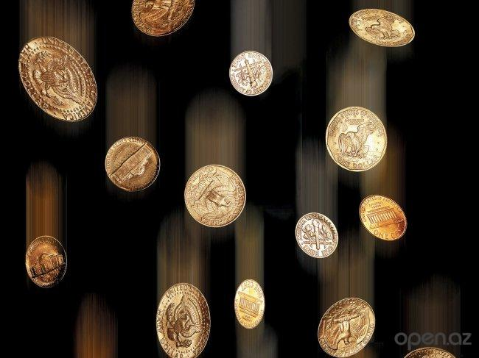
Functions of Money
Money is a medium of exchange, a measure of value, a store of value and a standard of deferred payments.

Slide 4
1. Medium of exchange
The most important function of money is that it acts as medium of exchange. Money is accepted freely in exchange for all other goods. Barter system is very inconvenient.
So the introduction of money has got over the difficulty of barter.

Slide 5
2. Measure of value
Money acts as a common measure of value.
It is a unit of account and a standard of measurement.

Slide 6
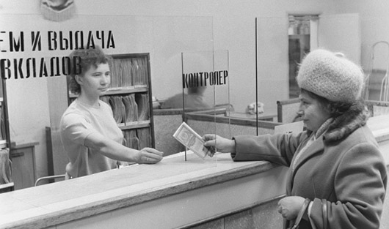
3. Store of value
A man who wants to store his wealth in some convenient form will find money admirably suitable for the purpose.
It acts as a store of value.

Slide 7
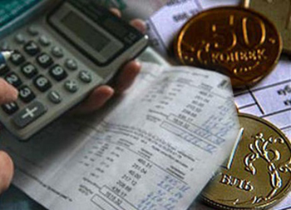
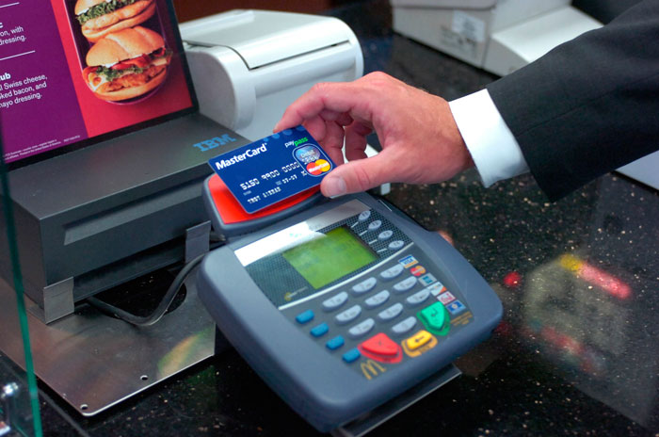
4. Standard of deferred payments
Money is used as a standard for future (deferred) payments. It forms the basis for credit transactions.

Slide 8
Importance of Money
Money is one of the most fundamental inventions of mankind “Every branch of knowledge has its fundamental discovery. In mechanics, it is the wheel, in science fire, in politics the vote. Similarly in economics, in the whole commercial side of Man’s social existence, money is the essential invention on which all the rest is based” (Crowther).

Slide 9
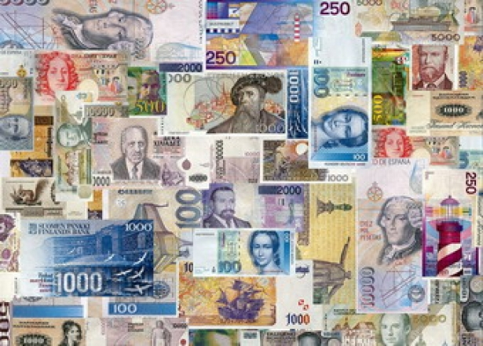
Importance of Money
Money is indispensable in an economy whether it is capitalistic or socialistic. Price mechanism plays a vital role in capitalism. Production, distribution and consumption are influenced to a great extent by prices, and prices are measured in money.

Slide 10
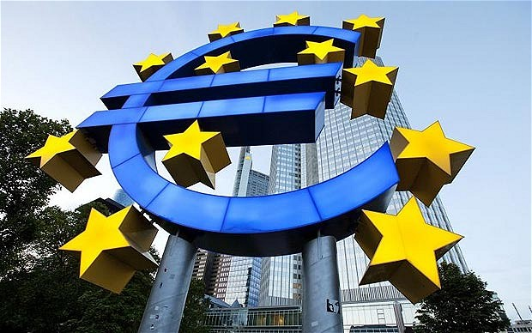
Money Supply
The Central bank of each
country manages the monetary system of country. It has classified
the money supply of country into four components.

Slide 11
Money Supply
M1 = Currency with the public. It includes coins and currency notes
+ demand deposits of the public.
M1 is also known as narrow money;
M2 = M1 + post office savings deposits;
M3 = M1 + Time deposits of the public with the banks.
M3 is also known as broad money;
M4 = M3 + total post office deposits.

Slide 12
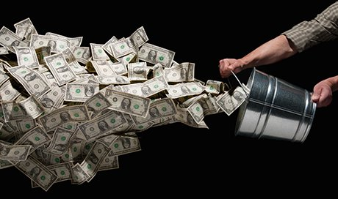
Reserve Money
Reserve Money (RM) may be considered as Government money.
Reserve money is the cash held by the public and the banks

Slide 13
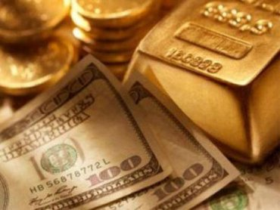
Reserve Money
It is composed of
C = currency with the public in circulation
OD = other deposits of the public CR = cash reserves of banks.
Reserve Money (RM) = C+ OD + CR

Slide 14
Monetary Policy
The basic goals of macroeconomic policy in most of the countries are
- full employment,
- price stability,
- rapid economic growth,
- balance of payments equilibrium
- economic justice.
Economic justice refers to equitable distribution of income. The government tries to achieve the goals through macroeconomic policy.

Slide 15
Instruments of Monetary Policy
Roughly we may say that monetary policy is credit control policy.
The instruments of credit control can be broadly divided into :
Quantitative credit control measures;
Selective credit control measures.

Slide 16
Instruments of Monetary Policy
Quantitative credit control instruments include bank rate policy, variation of cash reserve ratios and open market operations.
1. Bank Rate : The Bank rate is the minimum rate at which the central bank of a country will lend money to all other banks.

Slide 17
Instruments of Monetary Policy
Suppose, there is too much of money in circulation. Then the central bank should take some money out of circulation. It can do it by increasing the bank rate.

Slide 18
Instruments of Monetary Policy
When the bank rate goes up, the rates charged by other banks go up.
The belief is that if the rate of interest goes up, businessmen will be
discouraged to borrow more money and producers will borrow less money for investment. Generally, to control inflation, the central bank will increase the bank rate.

Slide 19
Instruments of Monetary Policy
2. Variation of cash Reserve Ratios : The ability of a commercial bank to create credit depends upon its cash reserves.
The central bank of a country has the power to vary the cash reserve ratios. During inflation, to check the sharp rise in commodity prices and to control credit, the central bank can make use of this weapon.

Slide 20
Instruments of Monetary Policy
3. Open Market Operations.
The success of open market operations as a weapon of credit control, depends mainly on:
the possession by the central bank of adequate volume of securities;
the presence of well developed bill (securities) market;
stability of cash reserve ratios maintained by commercial banks.

Slide 21
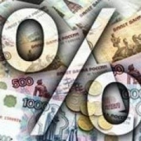
Selective credit controls
Selective credit controls can play an important role in an underdeveloped money market with a planned economy. Unlike the instruments of quantitative credit control, the selective instruments affect the types of credit extended by commercial banks.
They not only prevent flow of credit into undesirable channels, but also direct the flow of credit into useful channels.

Slide 22
Selective credit controls
The weapons of selective credit controls include:
Fixing minimum margin of lending or for purchase of securities.
Ceiling on the amount of credit for expansion
Different rates of interest will be charged to encourage certain sectors and to discourage certain other sectors
the central bank will persuade the commercial banks to follow certain policies through moral suasion

Slide 23
Monetary Transmission
Dear Money policy
When there is inflation in a country, the central bank tries to control it by following dear money policy. The term “Dear Money” refers to a phase or policy when interest rates are high.

Slide 24
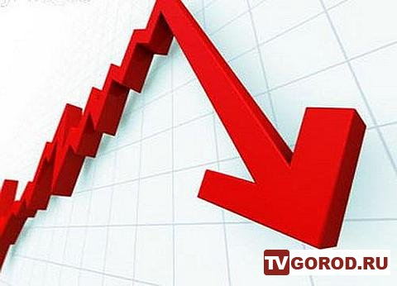
Monetary Transmission
Cheap Money policy
“Cheap Money” denotes a phase in which loans are available at low rates of interest or a policy which creates this situation. Cheap money policy is followed by a central bank during a period of depression to increase the supply of money so as to stimulate investment.

Slide 25
Monetary Transmission
Value of money
By “Value of Money” we mean the purchasing power of money.
The purchasing power of money depends upon the price level. A general rise in the price level indicates a fall in the value of money and a general fall in prices indicates a rise in the value of money.

Slide 26
The Quantity Theory of Money and the Equation of Exchange
The Quantity Theory of Money was formulated by Irving Fisher.
In its original form, the quantity theory states, “prices always change in exact proportion to changes in the quantity of money. If the amount of money is doubled, prices double. If the amount of money is halved, prices fall to half their original level”.
The main point about the quantity theory is that price level changes because of changes in the quantity of money.

Slide 27
Equation of Exchange
The quantity theory of money has been put forward in the form of an equation known as the “Equation of Exchange”.
The equation of exchange states that if ‘M’ is the amount of money,
‘V’ is the velocity of circulation of money,
‘P’ is the price level,
‘T’ is the volume of trade,
MV = PT (or P = MV/T)

Slide 28
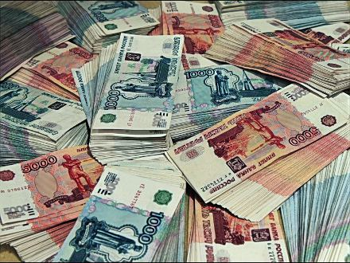
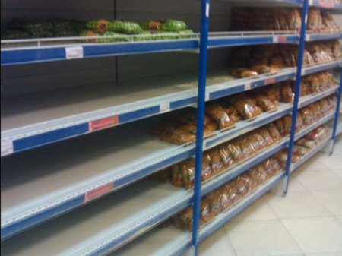
Types of Inflation
1. Demand – Pull Inflation: It is loosely described as “too much money chasing too few goods”. This refers to the situation where general price level rises because the demand for goods and services exceeds the supply available at the existing prices.

Slide 29
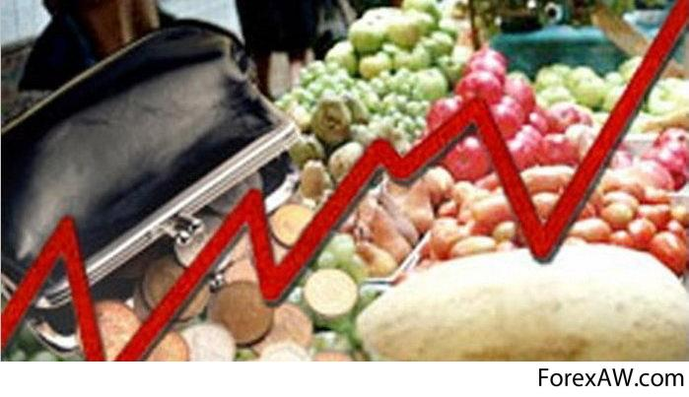
Types of Inflation
Runaway or Galloping or Hyper – Inflation
This is a serious type of inflation. Prices rise to a very great extent at high speed and high prices have to be paid even for cheap things. And money
becomes quite worthless and new currency has to be introduced. This
situation is known as galloping inflation or hyper-inflation.

Slide 30
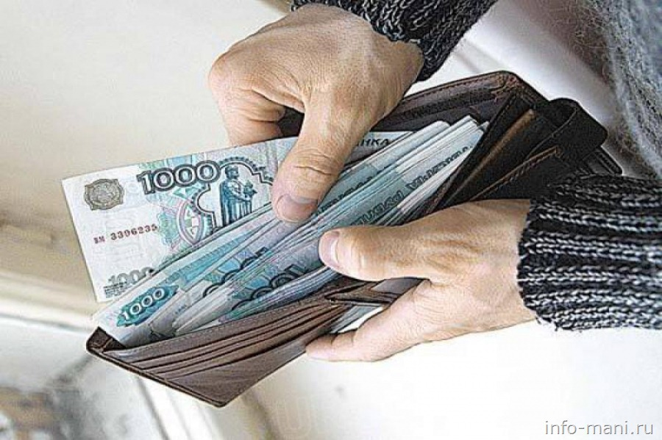
Types of Inflation
2. Cost – Push Inflation
Cost – push inflation is induced by rising costs, including wages, so that rising wages and other costs push up prices. We can also speak of wage inflation or price inflation when we mean increase in wages or prices.

Slide 31
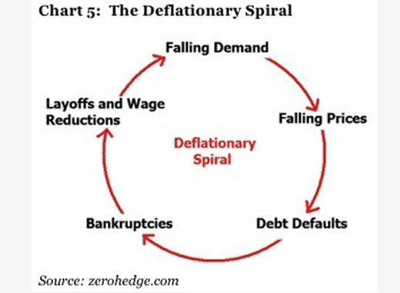
Deflation
Crowther, defines deflation as a “state in which the value of money is rising, i.e., prices are falling”.

Slide 32
Effects of changes in prices
1. Effects on production
If prices are rising, it will stimulate production. Under a capitalistic system, production is carried on mainly for profits. During a period of rising prices (inflation), there will be abnormal profits. This increases production. So manufacturers and businessmen gain during inflation.

Slide 33
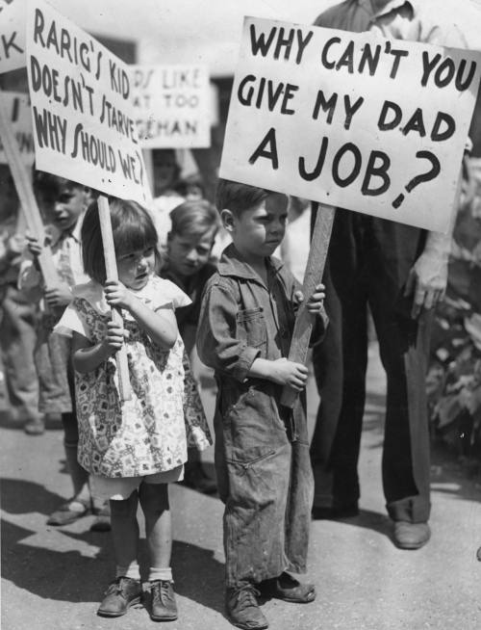
Effects of changes in prices
1. Effects on production
In a period of falling prices, businessmen incur huge losses because prices fall faster than costs. And there will be little scope for investment.
This results in unemployment on large scale. There will be business depression. During depression, money may be cheaply available, prices of materials will be low, men will be available for work but there will be no investment, no employment, no incomes and no demand for goods.

Slide 34
Effects of changes in prices
2. Effects on Distribution
a) Business class: During inflation, manufacturers and businessmen make huge profits. Of course, during deflation, they make losses.
b) Fixed income groups: People in fixed income groups are hit hard in times of inflation. The incomes of wage earners and salaried people such as teachers, clerks and judges do not increase as fast as prices. Even retired people getting pension are also affected during inflation.

Slide 35
Effects of changes in prices
2. Effects on Distribution
c) Investors: people who have invested their money in “gilt edged” securities (government securities) will get only fixed income. So their position is like those in the fixed income group. But those who have shares in companies will make profits during a period of rising prices and lose during a period of falling prices.
d) Rentiers: Rentiers gain during deflation and lose during inflation. But the gain during deflation is only a temporary feature.

